Slide 1


TASK 3 : AI COURSE
By Bassant Reda

Slide 2
TABLE OF CONTENTS
01
WHAT IS RUNTIME COMPLEXITY
02
HOW TO CALCULATE RUNTIME COMPLEXITY
03
2 TYPES OF SREACH

Slide 3

01
WHAT IS RUNTIME COMPLEXITY ?
It’s the reference to the efficiency of a programming algorithm in the terms of its execution time depending on the size of the input assigned to it

Slide 4

HOW TO CALCULATE RUNTIME COMPLEXITY ?

Slide 5
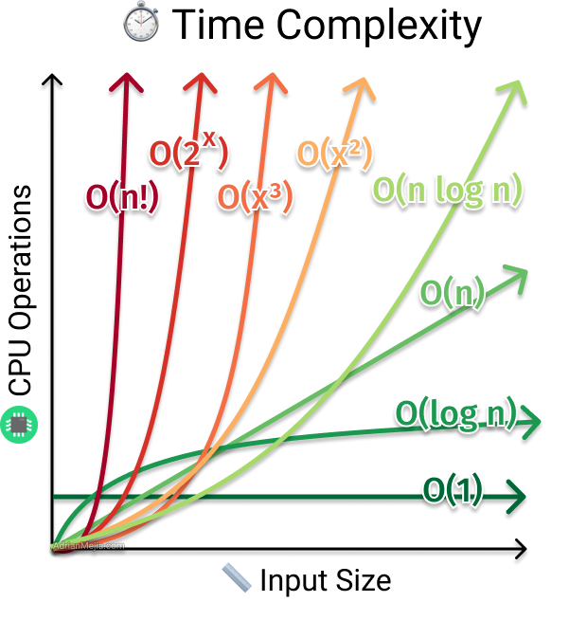
So how we calculate time complexity for an algorithm?
It is often expressed using Big O notation, which describes the upper limit of an algorithm's growth rate (worst case scenario in terms of time relative to the size of input)
Using the Big O notation (Big order function) :
We take in consideration the runtime complexity of each part of the algorithm including : basic operation ,if statement ,..etc. And how it affects the algorithm combined. And special consideration to loops, nested loops and recursive calls as it significantly affect the complexity of an algorithm (leading to a dramatic increase in it )
Big O notation neglect constants and lower order term as it doesn’t significantly have an effect on complexity calculation For example O(3*n^2 + 10n + 10) becomes O(n^2).
V.I : we also take in consideration Amount of work the CPU has to do (time complexity) as the input size grows (towards infinity).

Slide 6

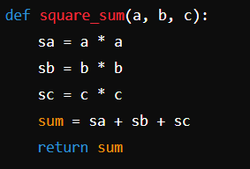
CONSTANT TIME O(1)
01
for basic operation in including arithmetic operation ,rational operation ,assignments and reading variables ,if statements they are considered to take constant time regardless of size of inputs
for example:
i += 1
(single multiplication) (it still can be calculated differently depending on time of execution of this operation)
i*2
(single multiplication)
i/2
(single division)
Adding of the number of statements the total time of function (T(n)) = O(1) regardless of the input size

Slide 7
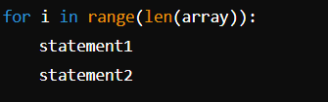
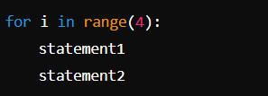
LINEAR TIME O(N)
For example: her we can assume that the worst case scenario for this loop to iterate through all the array length which will lead to T(n)=O(n) where n is the size of the array ,note that even if it iterate through n/2 the t(n) will still be O(n) as we drop constants
Note that it differ in case of loops of fixed number of iterations ,the runtime will be constant O(1) as it no longer depends on the input size

Slide 8
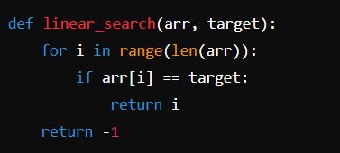
Another common example is LINEAR SREACH as we need to pass through each in to find our target

Slide 9
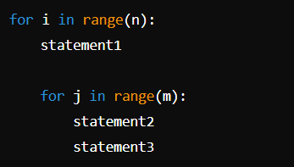
QUADRATIC TIME O(N^2)
Most famous example is nested loops ,although a single loop that iterate in through size n has a T(n)=O(n).
Nested loops is different case as we multiple runtime of each loop to find T(n)
For example : here we have two nested loops of T(n)=n*n=O(n*2)

Slide 10
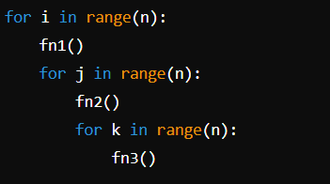
Calculation can differ with function calling included or different increments methods
In case of this example we have) a T(n)=n*n*n= O(n*3),BUT considering the presence of three functions calling we must take into account The runtime of each of them
In case there are all of O(1),total time will remain as it is
In case one of if has O(n^2) runtime while the other is constant ,then T(n)=n^5

Slide 11
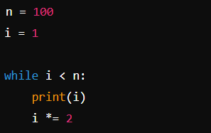
LOGARTHIMIC TIME O(logN)
for loops with multiplied incrementation or divided incrementation the total time becomes of
O(log n) a s it increases or decreases exponentially through iterations

Slide 12
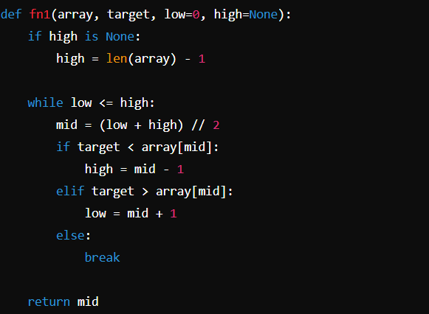
Another example BINARY SREACH which it idea depends on dividing the interval (array ,lists..etc)
To half in order to find the desired element
.

Slide 13
TWO TYPES OF SREACH
01
02
JUMP SREACH
EXPONENTIAL SREACH

Slide 14
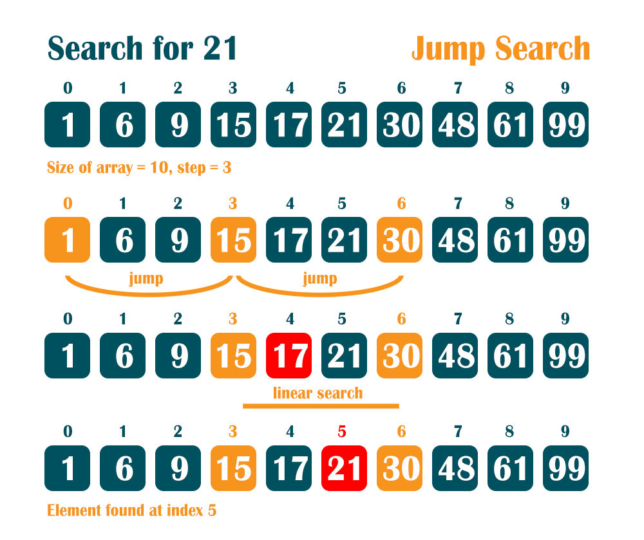
JUMP SREACH
Jump search is an advanced version of linear search with the linear search method!!
It take number of jump n and compare the element in the high end of the array with the target until the element is greater than the target then start linear search to find the target
Time complexity of js is greater than linear search and lower than binary search (ls>js>bs)
JUMP SREACH

Slide 15
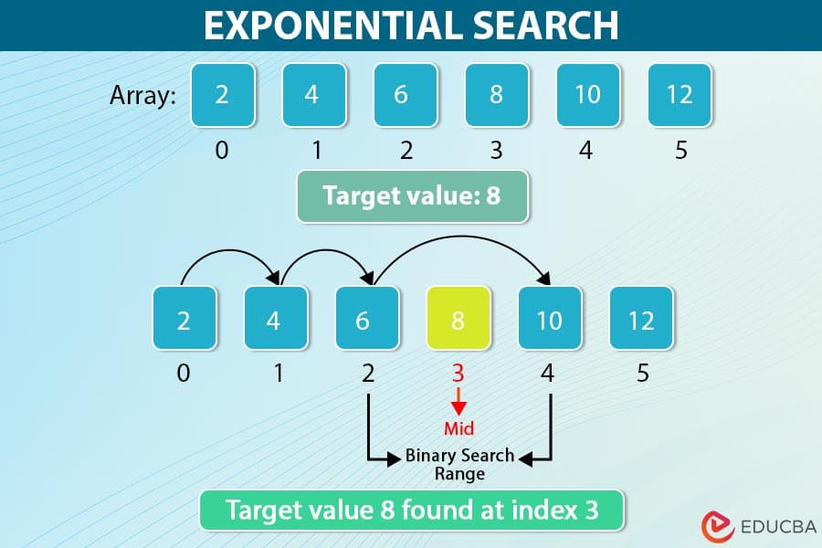
EXPONENTIAL SREACH
Exponential search depends on incrementing exponentially through the array compare the element in the high end of the array with the target while not be greater than the target until we find the target or get out the bounders of the array then start binary search with divide and conquer method
It has a time complexity of O(log n) as the increment method go faster than the binary method

Slide 16

THANK YOU!

